Slide 1
Water Simulation using OpenGL
0656151 周彥儒
0656639 唐仕超

Slide 2
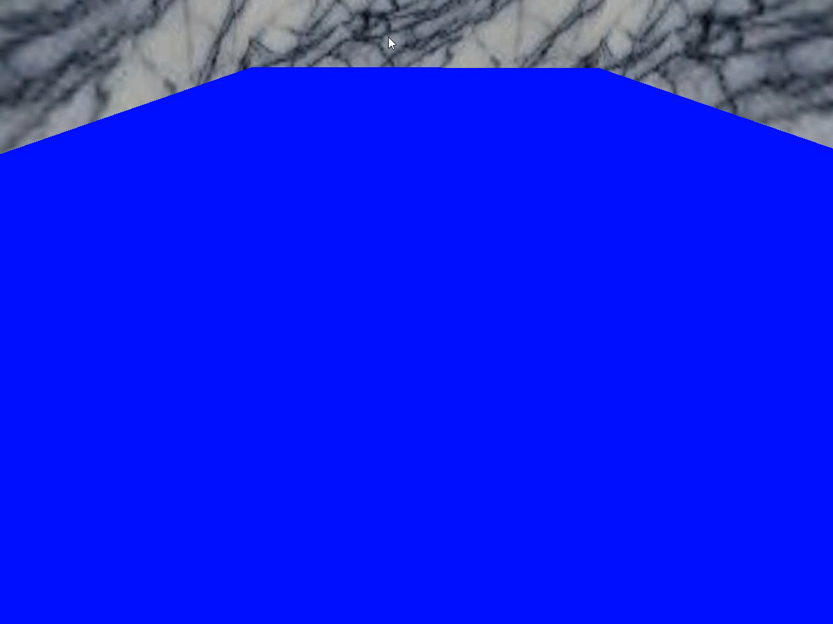
Water and the whole scene
Initially, the water is rendered as a flat quad.

Slide 3
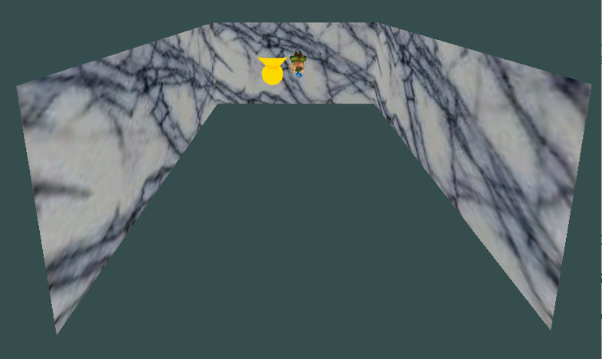
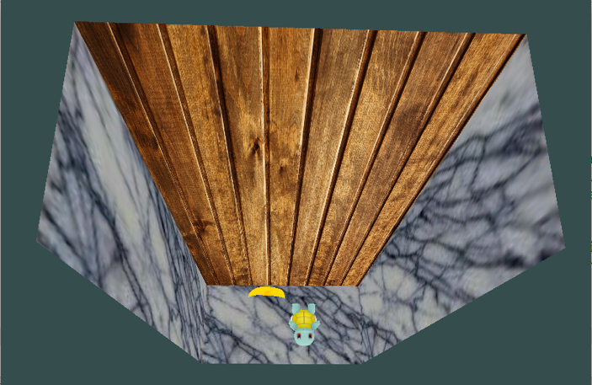
Frame buffer object
Before rendering the water, we'll take two pictures of the scene.
One of everything under the water which we'll save in the refraction texture.
One of everything above the water which will be the reflection texture.

Slide 4
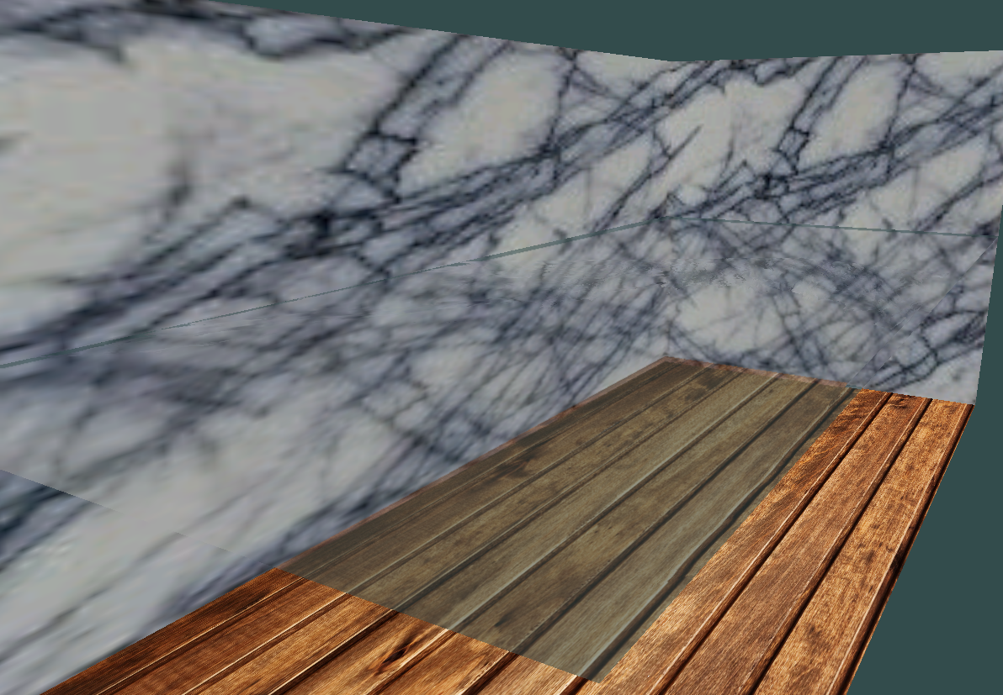
Projective texture mapping
We have both the reflection and refraction textures now, and we do projective texture mapping to map the textures onto the water surface.

Slide 5
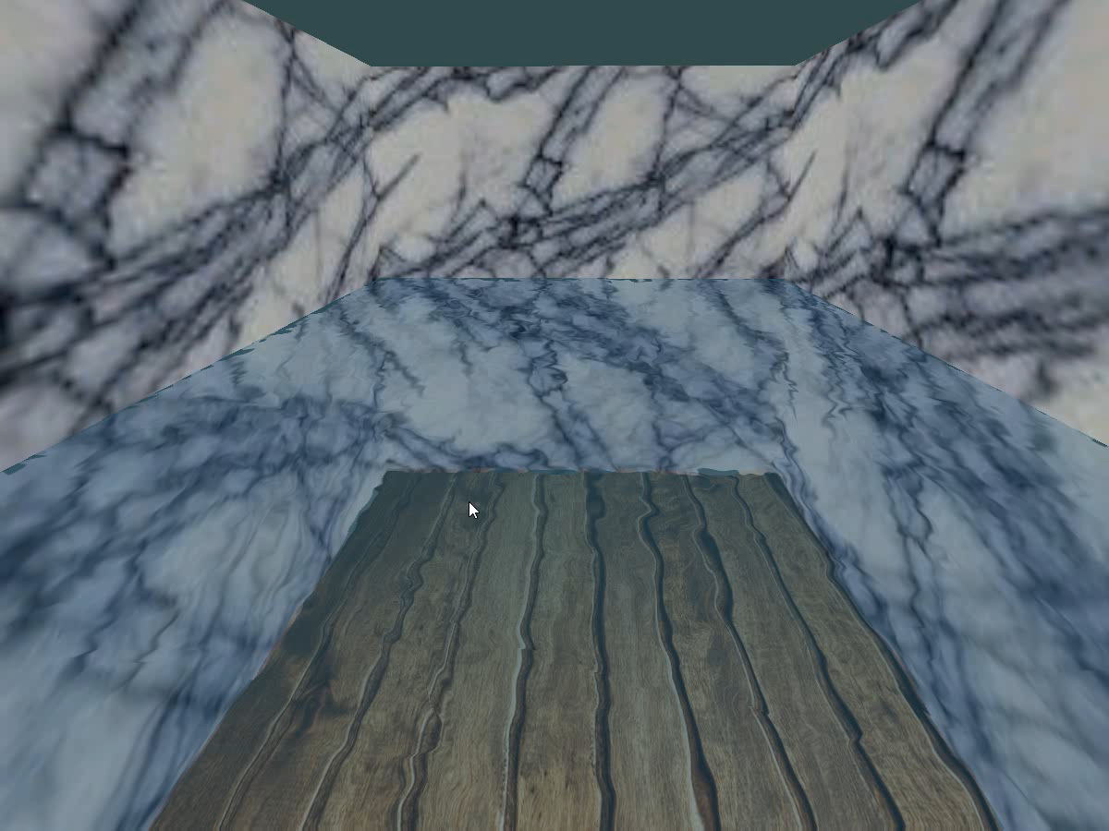
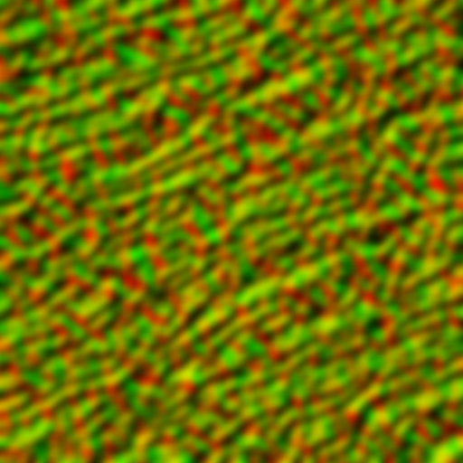
Rippling effect
Instead of just texturing the water, we first distort these two textures using DuDv map.The distortion will change over time, giving the impression that the textures are rippling.

Slide 6
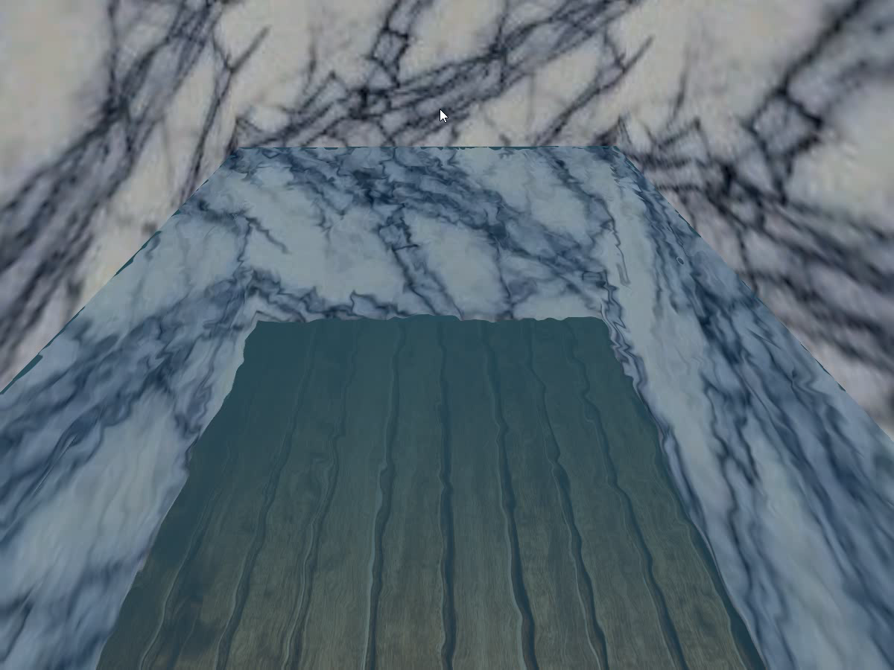
Fresnel effect
This determines how much of each texture should be seen based on the viewing angle.

Slide 7
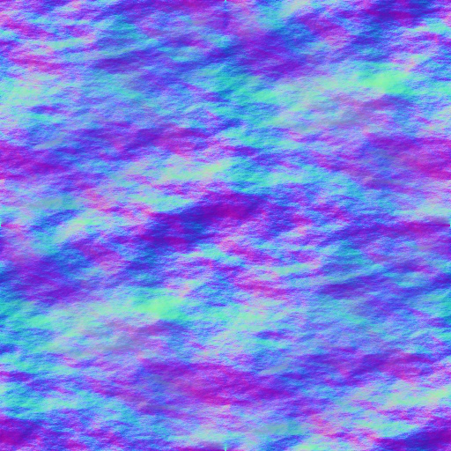
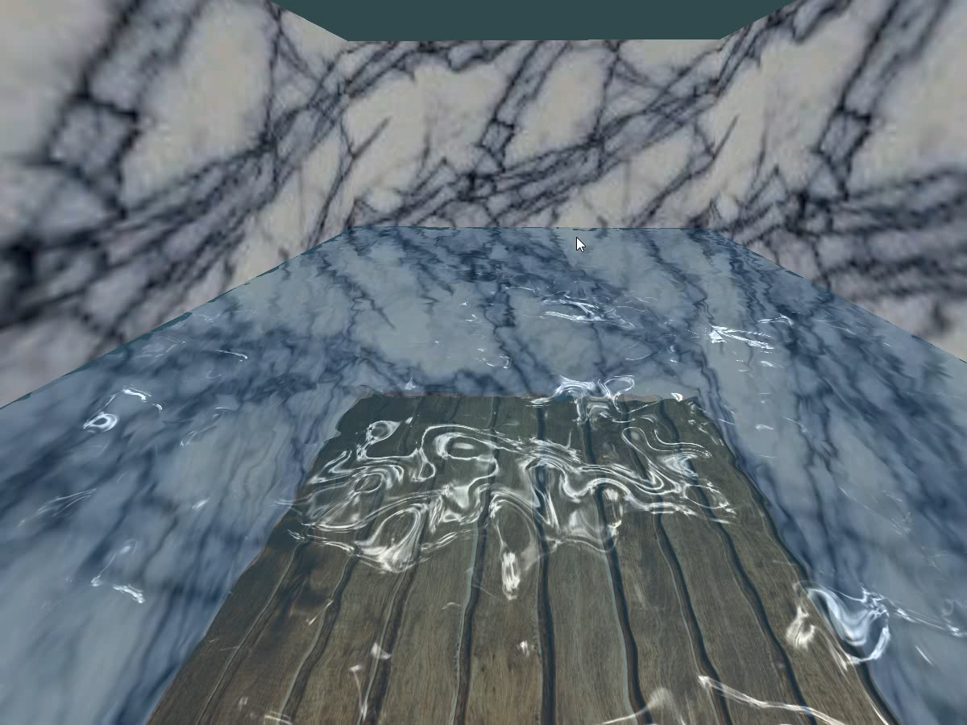
Specular highlight
Similar to homework 3, we use normal mapping to add specular highlights to the water’s surface.

Slide 8
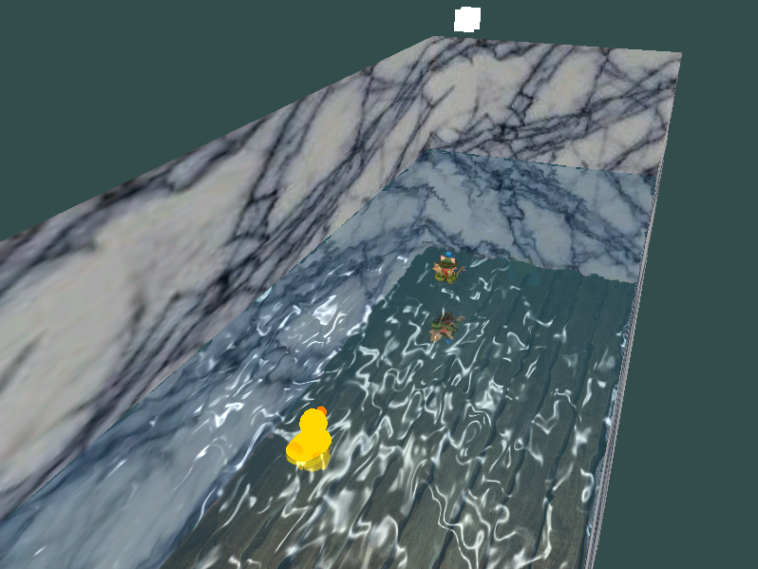
We also add some models !

Slide 9
DEMO

